Slide 1
Experiences with Food Fortification in Asia
Micronutrient Fortification of Foods: Science, Application & Management,
New Delhi
January 07, 2011
Dr Deepika Chaudhery, Micronutrient Initiative, Asia

Slide 2
Presentation Outline
Food fortification strategies
Elements for program success
Key challenges

Slide 3

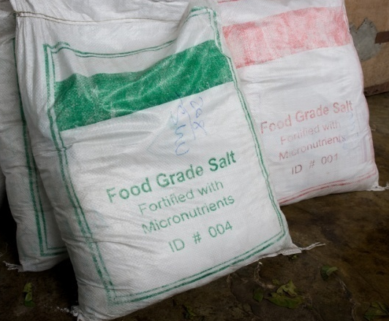
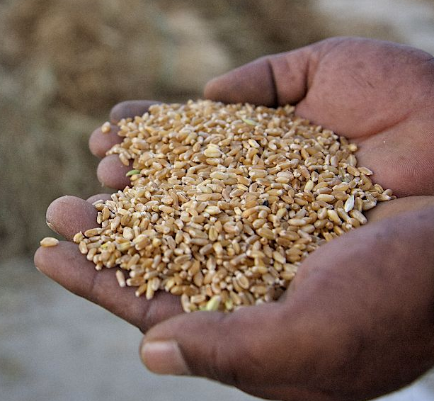
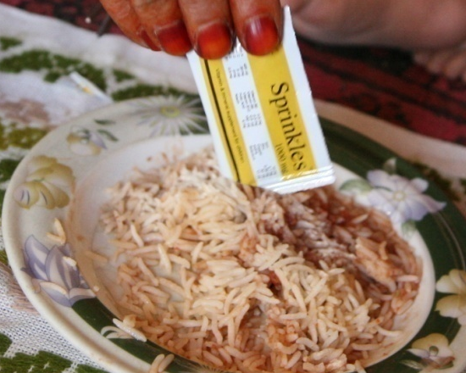
Food Fortification Strategies
Salt Iodisation
Double Fortified Salt
Wheat Flour Fortification
Multiple Micronutrient Powders or Sprinkles

Slide 4
Salt Iodisation - 1
Involved at the country level in revitalizing and facilitating the development of national salt iodisation strategies
Providing technical and operational support and creating tools specific for small scale processors to use to improve their own quality assurance
Technical and operational support to the salt iodisation program globally produced 1.3 million MT of adequately iodized salt

Slide 5
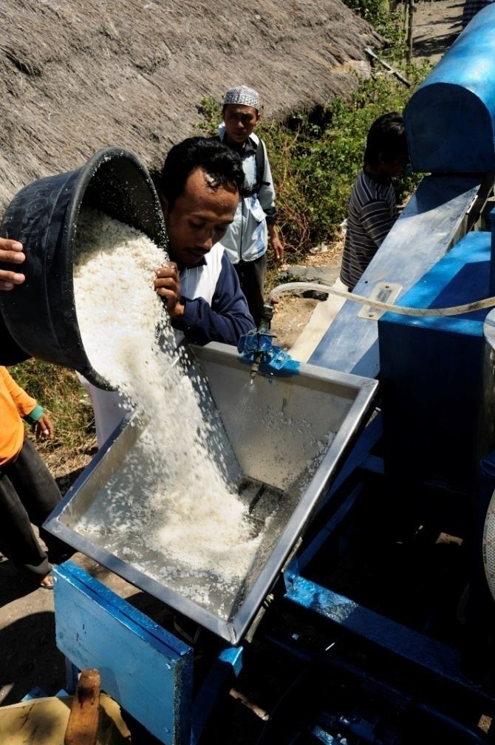
Salt Iodisation - 2
Countries | Iodised salt production (2010) | People reached
Bangladesh | 92,154 MT | 23 million
India | 649,343 MT | 162 million
Indonesia | 45,985 MT | 15 million
Pakistan | 355,243 MT | 89 million

Slide 6
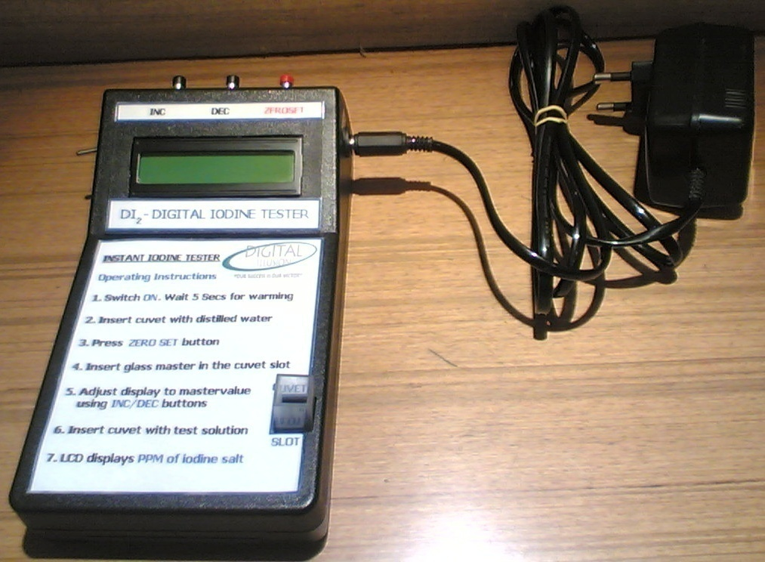
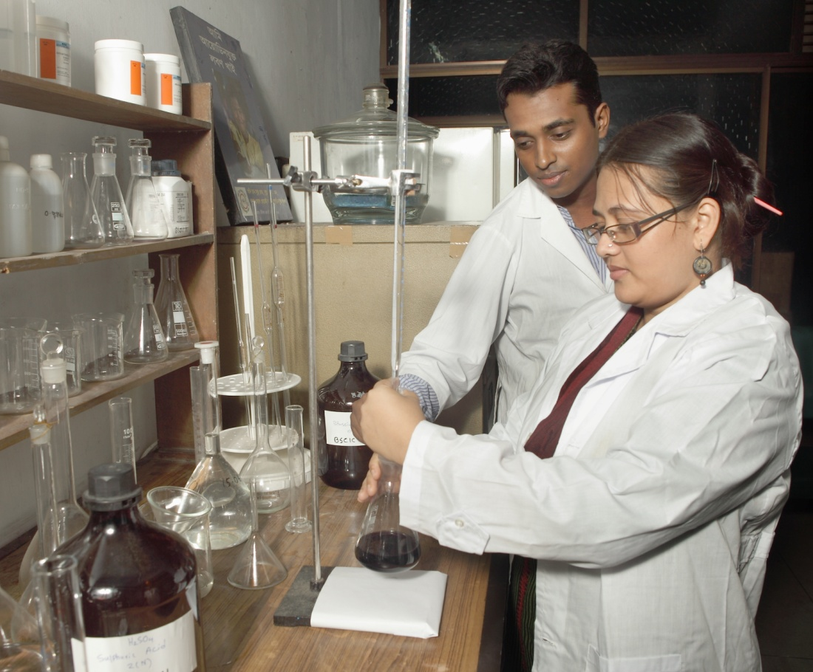
Monitoring the Quality of Salt
Rapid Testing Kit
Titration method

Slide 7
Challenges to Universal Salt Iodisation
Sustained political commitment
Salt moving up on the value addition ladder
Industry needs to evolve
Manual Mechanized
Fragmented Consolidated
Diligent internal monitoring
Committed enforcement
Product
Commodity
Raw Salt
Refined Salt
Processed Salt
Brand

Slide 8
Double Fortified Salt - 1
DFS is an innovative approach - delivering small but crucial amounts of iodine and iron to populations through their diet
In 1994, participated in an experiment to fortify iodized salt with iron and a technological breakthrough was achieved in 1998
DFS was demonstrated and the premix technology is now available
  Series of field trials
  Efficacy tests
  Consumer acceptability surveys

Slide 9
Double Fortified Salt - 2
A pilot project in partnership with the TNSC, a state government undertaking in 2004
Equipped the TNSC’s Valinokkam salt manufacturing facility with blending equipment for DFS production
First batch of DFS was distributed to 7 districts of Tamil Nadu
Production scaled up, and DFS reached all 29 districts
By 2008, TNSC was producing 300 tons of DFS per month benefitting 3.7 million children through the MDM scheme
Supporting the Government of Srilanka to introduce DFS through public channels

Slide 10
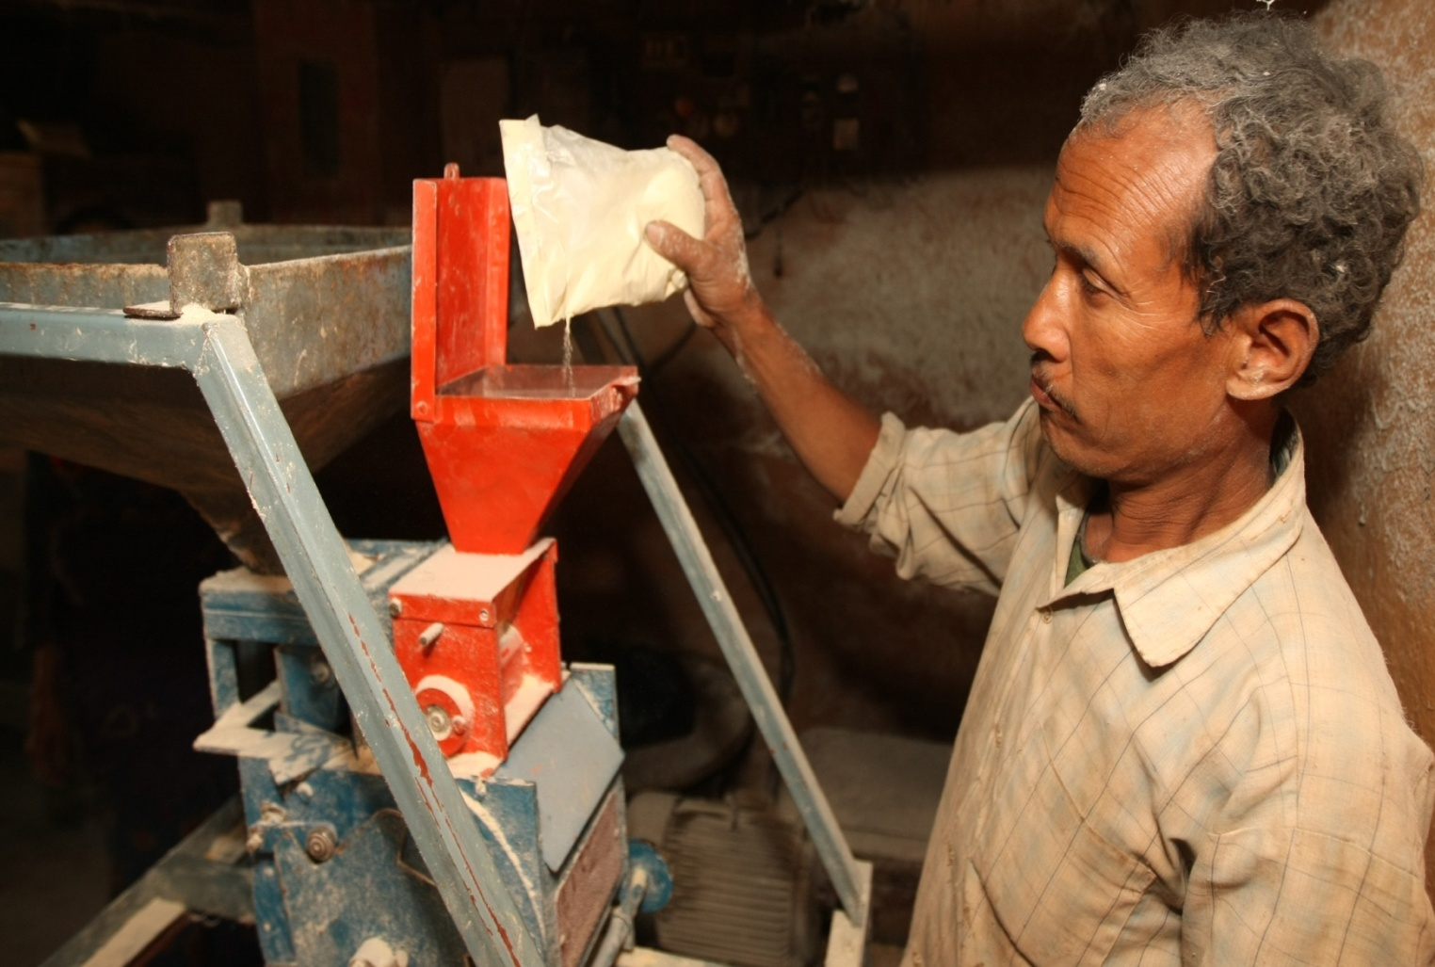
Addition of DFS Premix to Salt

Slide 11

Double Fortified Salt - 3
Study to examine whether consumption of DFS results in measurable changes in
productivity in female tea pickers
in a tea estate in West Bengal, India

Slide 12
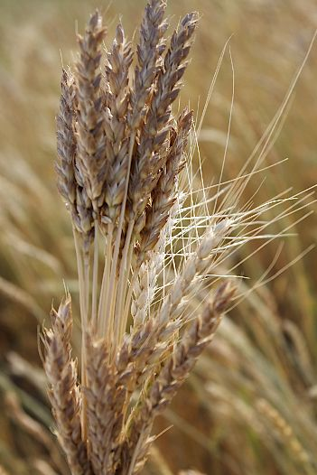
Wheat Flour Fortification - 1
Fortification of staple foods such as cereal flours with iron and folic acid
Providing support to Governments for wheat flour fortification
Wheat flour fortification programs in India, Pakistan and Nepal

Slide 13
Wheat Flour Fortification - 2
In India, MI host’s the secretariat for the India Flour Fortification Network (IFFN) in New Delhi
The network partners constitute flour miller associations, development partners GAIN, UNICEF, WFP, WHO and academic institutions
The focus of the network is to pilot introduction of wheat flour fortification through the public distribution systems in three wheat consuming states, namely Rajasthan, Madhya Pradesh and Bihar
  Sensitisation of government officials
  Training of mill owners
  Facilitating in developing the flour fortification standards

Slide 14
Wheat Flour Fortification - 3
The voluntary fortification of wheat flour at roller mills was launched by Nepal Flour Mills Association in 2008
  Provision of monitoring, supervision and quality assurance support
  The Government of Nepal to make the flour fortification at roller mills mandatory - government notice expected by March 2011
In Pakistan in 2010 67,000 MT of fortified wheat flour reached a population of approximately 800,000 in earthquake affected areas of Khyber Pakhtoonkhwa and Azad Jammu and Kashmir

Slide 15
Multiple Micronutrient Powders
A strategy to address iron deficiency anemia in young children
  Is the use of MNPs to enable the complementary food consumed by children to be fortified in the home with essential micronutrients, with appropriate counseling to caregivers
MNPs have gained acceptance in some countries in Latin America and Asia
In Bolivia and Guatemala -- nationally scale up MNPs

Slide 16

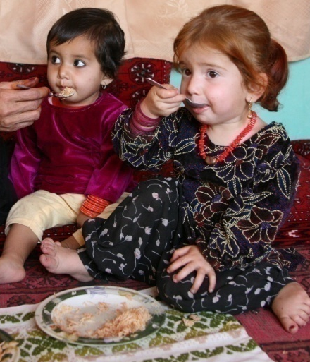
MNPs in Afghanistan -1
MNPs programmed in 11 priority provinces to reach 200,000 children 6 to 59 months
MNPs were highly accepted by the community
  Mothers readily mixed the MNPs in the food given to children, no smell or taste of the MNP reported
  Mothers reported increase in appetite and activity of their children

Slide 17
MNPs in Afghanistan - 2
Health providers strongly expressed that MNPs be included in the routine health services and expanded to other districts
Challenges included need for :
  Stronger BCC for generating awareness among caregivers
  Strengthening monitoring and supervision to facilitate compliance
  Stronger advocacy for awareness among policymakers

Slide 18
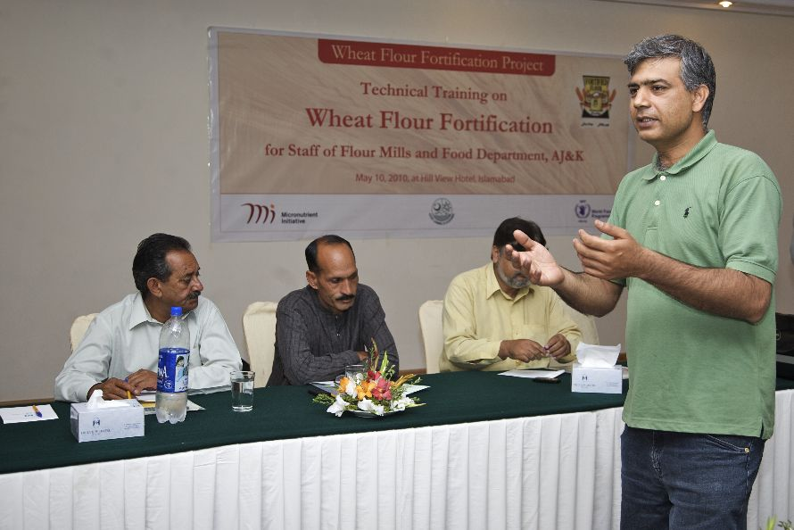

Elements for Program Success
Developing and nurturing champions and leaders at the country level and within Governments
Continuous investments in advocacy
Focused capacity building at all levels
A well developed Behavior Change Communication strategy
Monitoring and evaluation frameworks

Slide 19
Challenges
Lack of political commitment
Poor technical knowledge
Inadequate funding support
Inappropriate BCC strategy

Slide 20
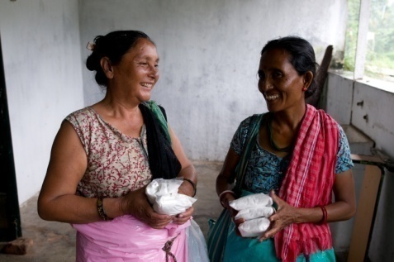
Thank You !

